Slide 1


Slide 2
DATA INTERPRETATION
1.1

Slide 3
TYPES OF DATA GRAPHS :
1. TABLE
2. BAR GRAPH
3. LINE GRAPH
4. PIE CHART
5. CASELETS

Slide 4
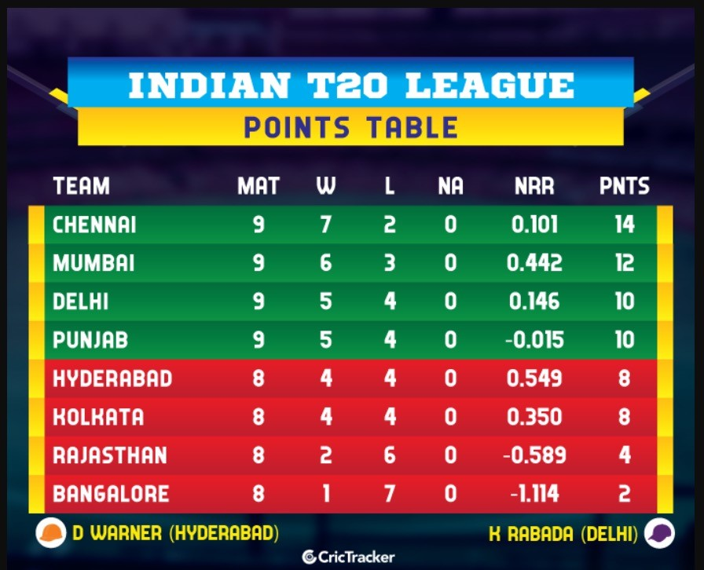
1.TABLE
Question 1
Notes:
Answer :ASK SOME BASIC QUESTIONS

Slide 5
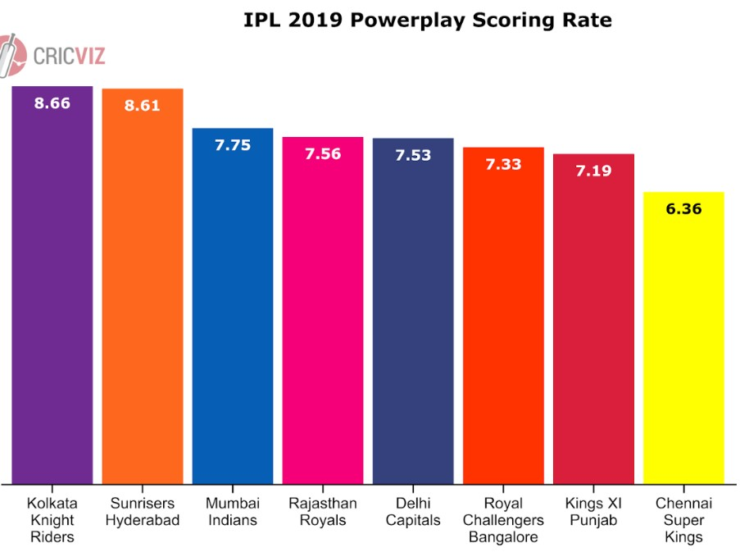
BAR GRAPH :
Notes:
Answer :ASK SOME BASIC QUESTIONS

Slide 6
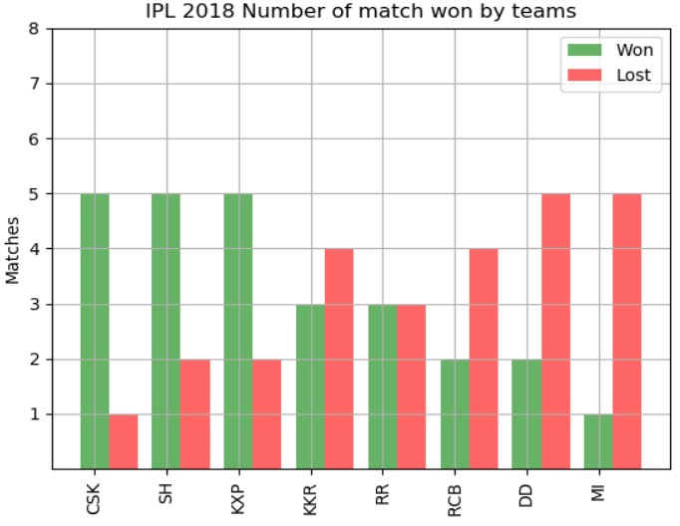
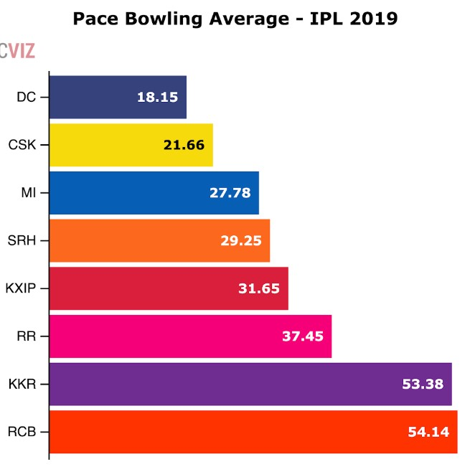
BAR GRAPH :
Notes:
Answer :ASK SOME BASIC QUESTIONS

Slide 7
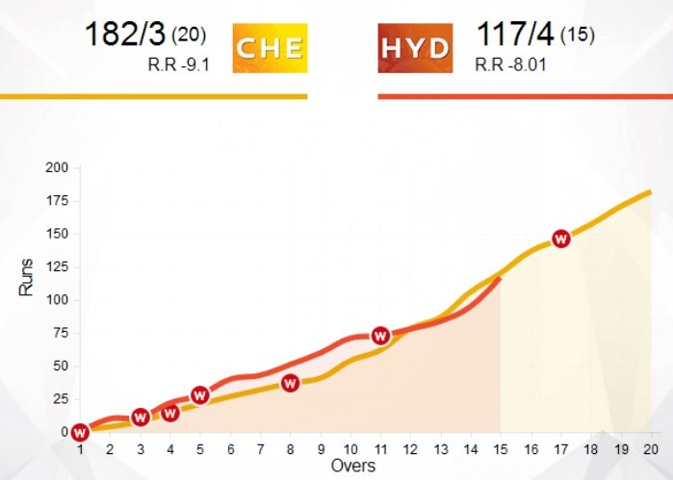
LINE GRAPH :
Notes:
Answer :ASK SOME BASIC QUESTIONS

Slide 8
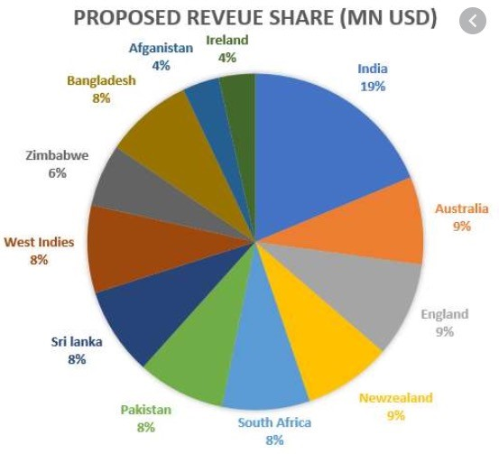
PIE CHART:
Notes:
Answer :ASK SOME BASIC QUESTIONS

Slide 9
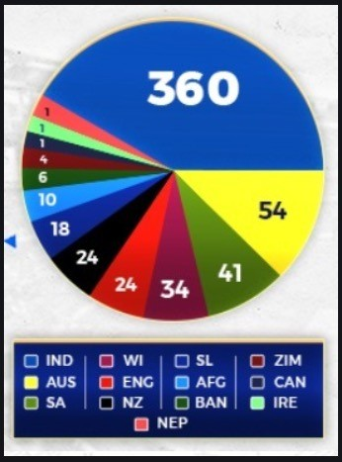
PIE CHART:
Notes:
Answer :ASK SOME BASIC QUESTIONS

Slide 10
Question 3
Categories of questions:
Calculations Based
Observation Based

Slide 11
Question 4
Requisites:
Percentages
Ratio
Averages
Time and Work
Time and Distance
-

Slide 12
Question 5
Question 5
Types of Choices and Approximation:
High-difference in values
Medium-difference in values
Low-difference in values

Slide 13
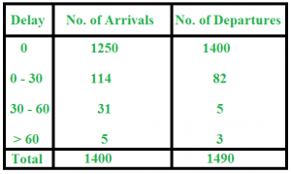
Question 1
Question 6
The following table contains the data on train arrival and train departure from a station. Study the table and answer the questions that follow :

Slide 14
Question 7
a) Find the number of trains that arrived late
b) Find the number of trains that departed late
c) Find the percentage of late-arriving trains
Notes:
Answer :
a) Number of trains arriving late = 114 + 31 + 5 = 150
b) Number of trains departing late = 82 + 5 + 3 = 90
c) Percentage of late arriving trains = (150 / 1400) x 100 = 10.71 %

Slide 15
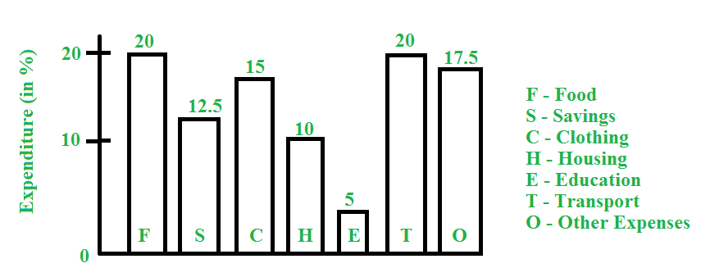
Question 2
Question 8
Study the following bar graph and answer the questions that follow: Total monthly income = Rs. 50,000

Slide 16
Question 9
a) What amount is spent on food ?
b) How much more money is spent on clothing and housing together than on transportation?
c) What percent of amount on food is spent as amount on education?
Notes:
Answer :
a) Food = 20 % of expenditure => Amount spent on food = 20% of 50,000 = Rs. 10,000
b) Money spent on clothing and housing together = 25 % of Rs. 50,000 = Rs. 12,500 Money spent on transportation = 20 % of Rs. 50,000 = Rs. 10,000 Therefore, more money spent on clothing and housing together than on transportation = Rs. 12,500-10,000 = Rs. 2,500
c) Expenditure on food = 20 % Expenditure on education = 5 % Therefore, percent of amount on food spent as amount on education = (5 / 20) x 100 = 25 %

Slide 17
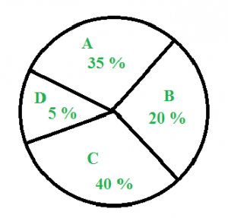
Question 3
Question 10
Study the pie chart below and answer the questions that follow :

Slide 18
Question 11
The above pie chart shows the sales of four different types of articles in a shop.
a) What is the central angle of type A ?
b) If the total sale is 1200, what is the sale of B ?
c) What is the difference between the central angle of C and D ?
Notes:
ANSWERS:
a) Central angle of A = Percentage of A x 360 degrees = (35 / 100) x 360 = 126 degrees
b) Sales of B = 20 % of 1200 = 240
c) Difference between the central angle of C and D = 40 % of 360 – 5 % of 360 = 35 % of 360 = 126 degrees

Slide 19
Question 4
Question 12
A company conducted a survey of 500 customers to determine their satisfaction with the company’s products. The results showed that 80% of customers were satisfied with the products. Of the satisfied customers, 60% were repeat customers. How many customers were repeat customers and satisfied with the products?
Notes:
Answer :
To determine the number of repeat customers who were satisfied with the products, we need to first calculate the total number of satisfied customers. The survey showed that 80% of 500 customers were satisfied with the products, so the number of satisfied customers is: 80% of 500 = 0.8 * 500 = 400. Now we can find the number of repeat customers who were satisfied with the products by multiplying the total number of satisfied customers by the percentage of satisfied customers who were repeat customers: 60% of 400 = 0.6 * 400 = 240. Therefore, there were 240 repeat customers who were satisfied with the products.

Slide 20
QUESTION 5
Study the following table and answer the questions based on it :

Slide 21
Question 14
Year | Delhi |  |  | H.P |  |  | U.P |  |  | Punjab |  |  | Haryana
 | App | Qual | Sel | App | Qual | Sel | App | Qual | Sel | App | Qual | Sel | App | Qual | Sel
1997 | 8000 | 850 | 94 | 7800 | 810 | 82 | 7500 | 720 | 78 | 8200 | 680 | 85 | 6400 | 700 | 75
1998 | 4800 | 500 | 48 | 7500 | 800 | 65 | 5600 | 620 | 85 | 6800 | 600 | 70 | 7100 | 650 | 75
1999 | 7500 | 640 | 82 | 7400 | 560 | 70 | 4800 | 400 | 48 | 6500 | 525 | 65 | 5200 | 350 | 55
2000 | 9500 | 850 | 90 | 8800 | 920 | 86 | 7000 | 650 | 70 | 7800 | 720 | 84 | 6400 | 540 | 60
2001 | 9000 | 800 | 70 | 7200 | 850 | 75 | 8500 | 950 | 80 | 5700 | 485 | 60 | 4500 | 600 | 75
Number of Candidates Appeared, Qualified and Selected in a Competitive Examination from Five States Delhi, H.P, U.P, Punjab and Haryana Over the Years 1994 to 1998

Slide 22
Question (a)
Question 12
For which state the average number of candidates selected over the years is the maximum?
Delhi
H.P
U.P
Punjab
Notes:
Answer: Option A
Explanation:
The average number of candidates selected over the given period for various states are:
For Delhi =94 + 48 + 82 + 90 + 70=384= 76.8.55
For H.P. =82 + 65 + 70 + 86 + 75=378= 75.6.55
For U.P. =78 + 85 + 48 + 70 + 80=361= 72.2.55
For Punjab =85 + 70 + 65 + 84 + 60=364= 72.8.55
For Haryana =75 + 75 + 55 + 60 + 75=340= 68.55
Clearly, this average is maximum for Delhi.

Slide 23
Question (b)
Question 12
The percentage of candidates qualified from Punjab over those appeared from Punjab is highest in the year?
1997
1998
1999
2000
Notes:
Answer: Option D
Explanation:
The percentages of candidates qualified from Punjab over those appeared from Punjab during different years are:
For 1997 =680/8200x 100% = 8.29%.
For 1998 =600/6800x 100% = 8.82%.
For 1999 =525/6500x 100% = 8.08%.
For 2000 =720/7800x 100% = 9.23%.
For 2001 =485/5700x 100% = 8.51%.
Clearly, this percentage is highest for the year 2000.

Slide 24
Question (c)
Question 12
In the year 1997, which state had the lowest percentage of candidates selected over the candidates appeared?
Delhi
H.P
U.P
Punjab
Notes:
Answer: Option D
Explanation:
The percentages of candidates selected over the candidates appeared in 1997, for various states are:
(i) For Delhi =94/8000x 100% = 1.175%.
(ii) For H.P. =82/7800x 100% = 1.051%.
(iii) For U.P. =78/7500x 100% = 1.040%.
(iv) For Punjab=85/8200x 100% = 1.037%.
(v) For Haryana75/6400x 100% = 1.172%.
Clearly, this percentage is lowest for Punjab.

Slide 25
Question (d)
Question 12
The number of candidates selected from Haryana during the period under review is approximately what percent of the number selected from Delhi during this period?
79.5%
81%
84.5%
88.5%
Notes:
Answer: Option D
Explanation:
Required percentage=[(75 + 75 + 55 + 60 + 75)/(94 + 48 + 82 + 90 + 70)x 100]%=[[340/384]x 100]%= 88.54%= 88.5%

Slide 26
Question (e)
Question 12
The percentage of candidates selected from U.P over those qualified from U.P is highest in the year?
1997
1998
1999
2001
Notes:
Answer: Option b
Explanation:
The percentages of candidates selected from U.P. over those qualified from U.P. during different years are:
For 1997 =78/720x 100% = 10.83%.
For 1998 =85/620x 100% = 13.71%.
For 1999 =48/400x 100% = 12%.
For 2000 =70/650x 100% = 10.77%
For 2001 =80/950x 100% = 8.42%
Clearly, this percentage is highest for the year 1998.

Slide 27
THANK YOU

